Slide 1
Sound structure of Ancient Greek Harmonia Modes:
Heterodyne resonance
and
differential bases
ISTD-07 (M-2)
Koji Sato, Ken Ito, Akinori Takei and Toru Toyoda, Division of Composition and Conducting, Interfaculty Initiative in Information Studies, The University of Tokyo

Slide 2
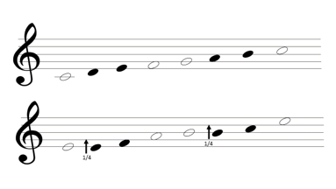
Ancient Greek Harmonia Modes
Literally studied, but musically not studied

Slide 3
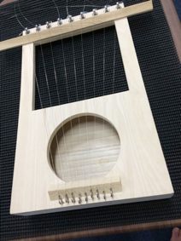
Reconstructed Kithara

Slide 4
Ancient Greek Harmonia Modes
Literally studied, but musically not studied

Slide 5
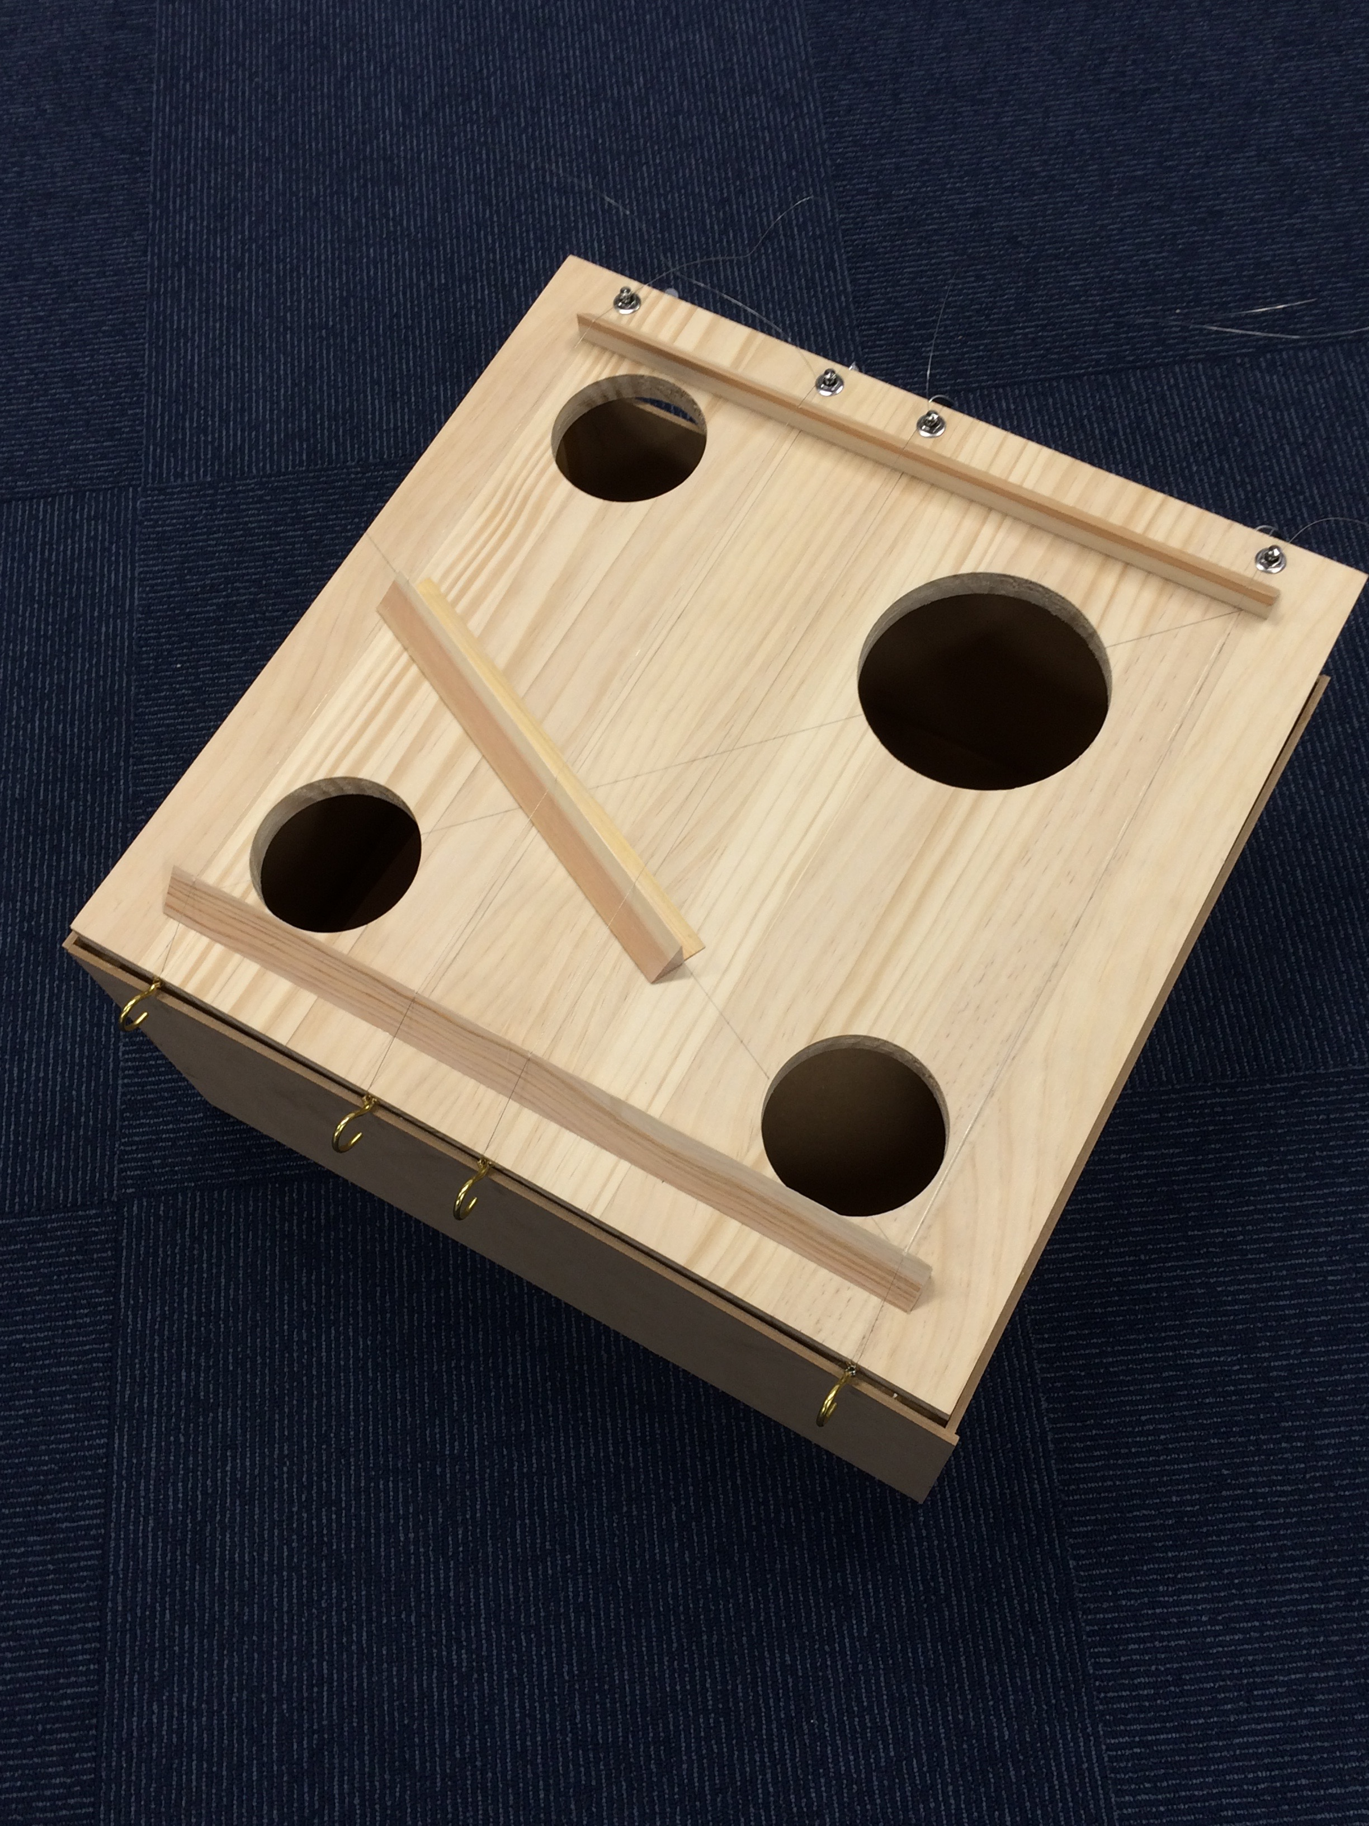
“Helikon” by Ptolemy
Morphoes

Slide 6
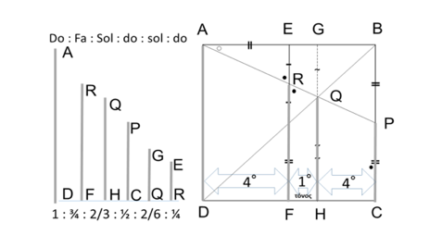
“Helikon” by Ptolemy

Slide 7
“Helikon” by Ptolemy
Length Ratio

Slide 8
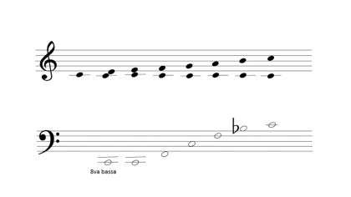
Differential fundamentals on diatonic scale
ratio

Slide 9
Differential fundamentals on diatonic scale
ratio
8:8

Slide 10
Differential fundamentals on diatonic scale
ratio
8:8
24/24

Slide 11
Differential fundamentals on diatonic scale
ratio
8:8
8:9
24/24

Slide 12
Differential fundamentals on diatonic scale
ratio
8:8
8:9
24/24
27/24

Slide 13
Differential fundamentals on diatonic scale
ratio
8:8
8:9
4:5
24/24
27/24

Slide 14
Differential fundamentals on diatonic scale
ratio
8:8
8:9
4:5
24/24
27/24
30/24

Slide 15
Differential fundamentals on diatonic scale
ratio
8:8
8:9
4:5
3:4
24/24
27/24
30/24

Slide 16
Differential fundamentals on diatonic scale
ratio
8:8
8:9
4:5
3:4
24/24
27/24
30/24
32/24

Slide 17
Differential fundamentals on diatonic scale
ratio
8:8
8:9
4:5
3:4
2:3
24/24
27/24
30/24
32/24

Slide 18
Differential fundamentals on diatonic scale
ratio
8:8
8:9
4:5
3:4
2:3
24/24
27/24
30/24
32/24
36/24

Slide 19
Differential fundamentals on diatonic scale
ratio
8:8
8:9
4:5
3:4
2:3
3:5
24/24
27/24
30/24
32/24
36/24

Slide 20
Differential fundamentals on diatonic scale
ratio
8:8
8:9
4:5
3:4
2:3
3:5
24/24
27/24
30/24
32/24
36/24
40/24

Slide 21
Differential fundamentals on diatonic scale
ratio
8:8
8:9
4:5
3:4
2:3
3:5
8:15
24/24
27/24
30/24
32/24
36/24
40/24

Slide 22
Differential fundamentals on diatonic scale
ratio
8:8
8:9
4:5
3:4
2:3
3:5
8:15
24/24
27/24
30/24
32/24
36/24
40/24
45/24

Slide 23
Differential fundamentals on diatonic scale
ratio
8:8
8:9
4:5
3:4
2:3
3:5
8:15
1:2
24/24
27/24
30/24
32/24
36/24
40/24
45/24

Slide 24
Differential fundamentals on diatonic scale
ratio
8:8
8:9
4:5
3:4
2:3
3:5
8:15
1:2
24/24
27/24
30/24
32/24
36/24
40/24
45/24
48/24

Slide 25
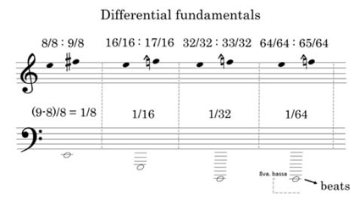
Differential fundamentals in Harmonia Mode

Slide 26
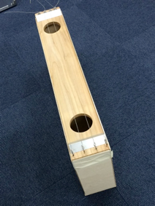
Reconstructed Lyre

Slide 27
Reconstructed Kithara

Slide 28
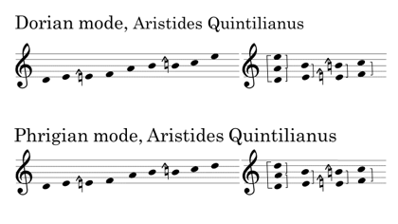
Examples of Harmonia Modes

Slide 29
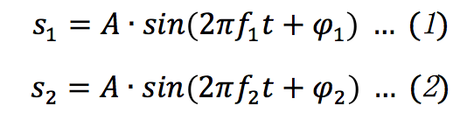
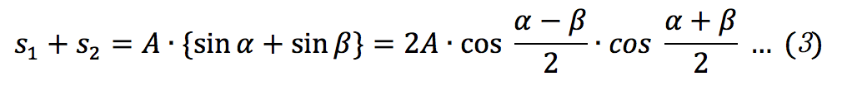
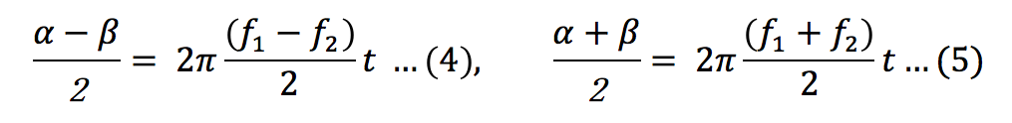
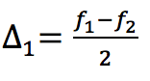
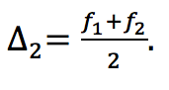

Heterodyne
Addition Theorem
Suppose frequency f1 and f2 (f1 > f2),

Slide 30
Heterodyne
Addition Theorem
Suppose frequency f1 and f2 (f1 > f2),

Slide 31
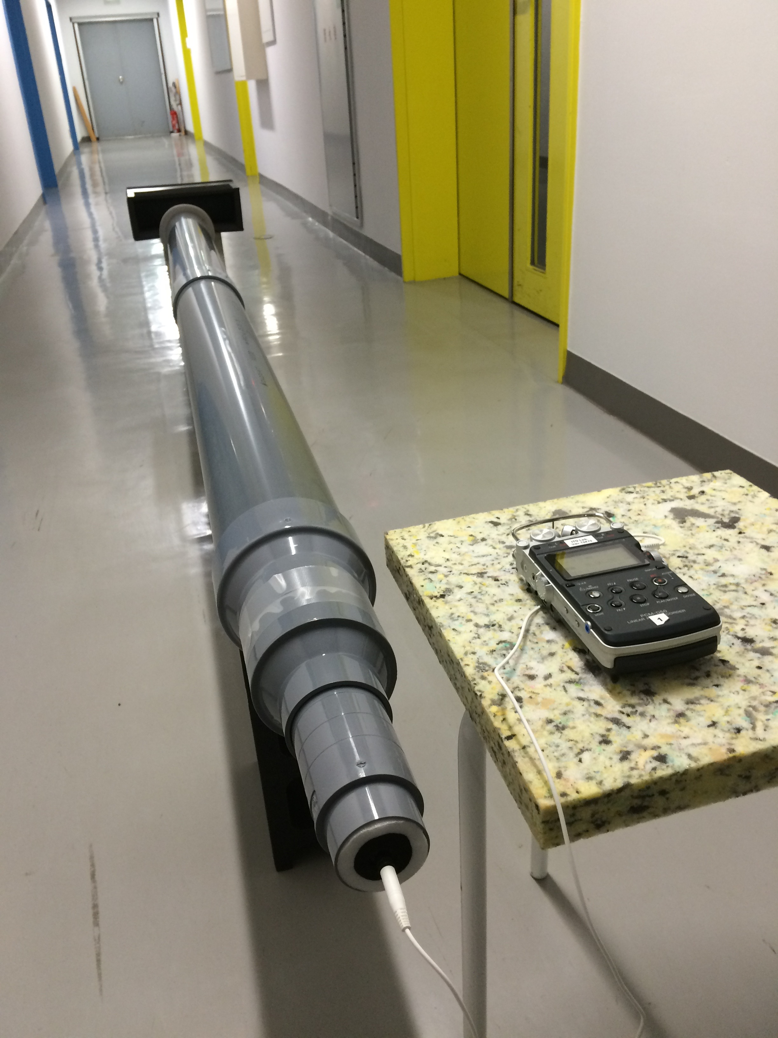
(Experiment) Input Heterodyne into Cavity (Physical Env.)

Slide 32

Heterodyne
Sine Wave 1024Hz

Slide 33
Heterodyne
Sine Wave 1152Hz

Slide 34
Heterodyne
Sine Wave 1024Hz
ー
Sine Wave 1152Hz
＝
?

Slide 35
Heterodyne
Sine Wave 1024Hz
ー
Sine Wave 1152Hz
＝
Sine Wave 128Hz

Slide 36
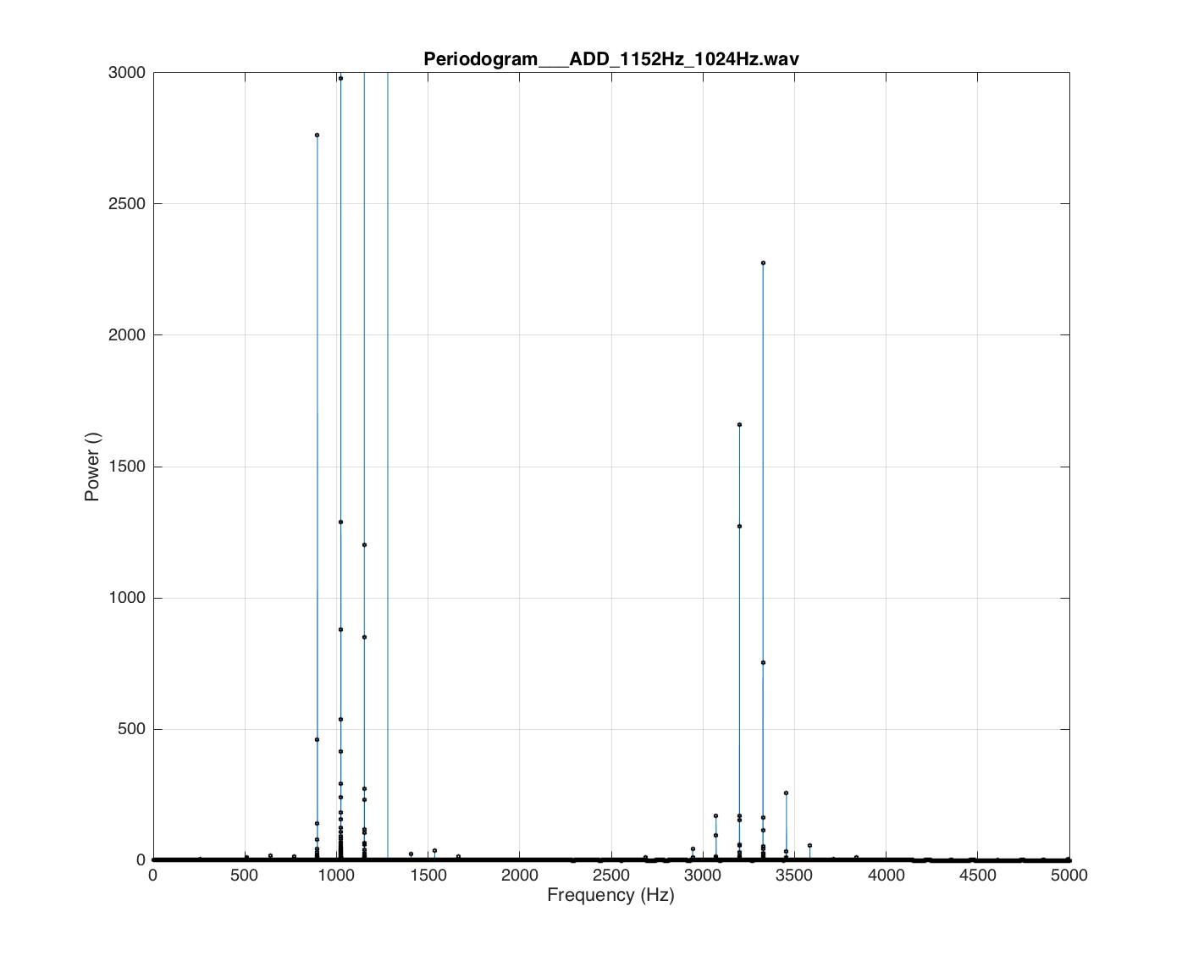
Generated Heterodyne
To input into the cavity

Slide 37
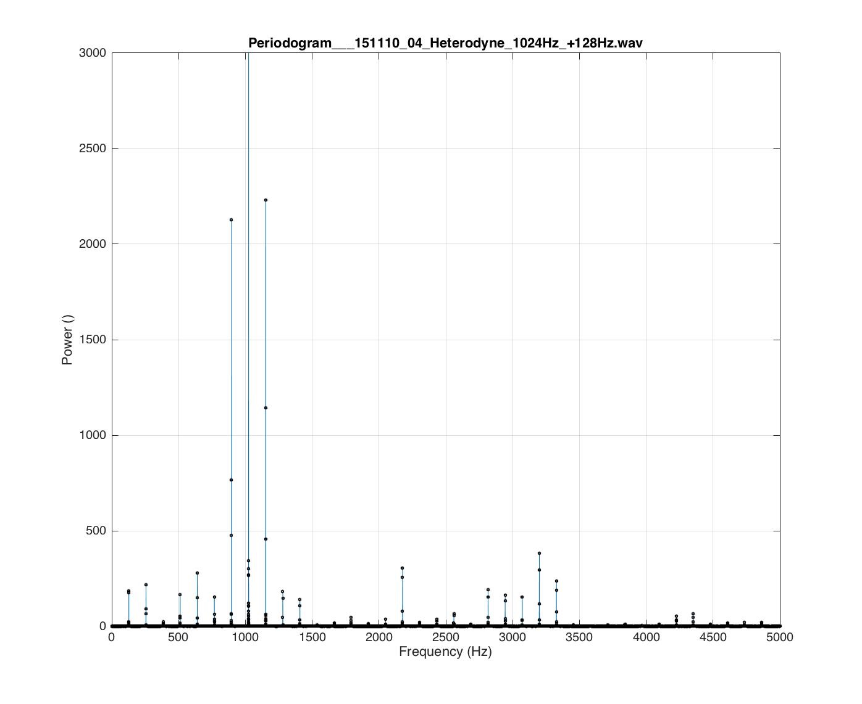
Resonnance in Cavity
Recorded Output

Slide 38
Resonnance in Cavity
Recorded Output
Over Tones

Slide 39
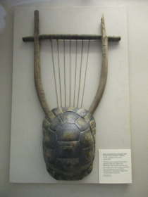
Kithara
British Museum

Slide 40
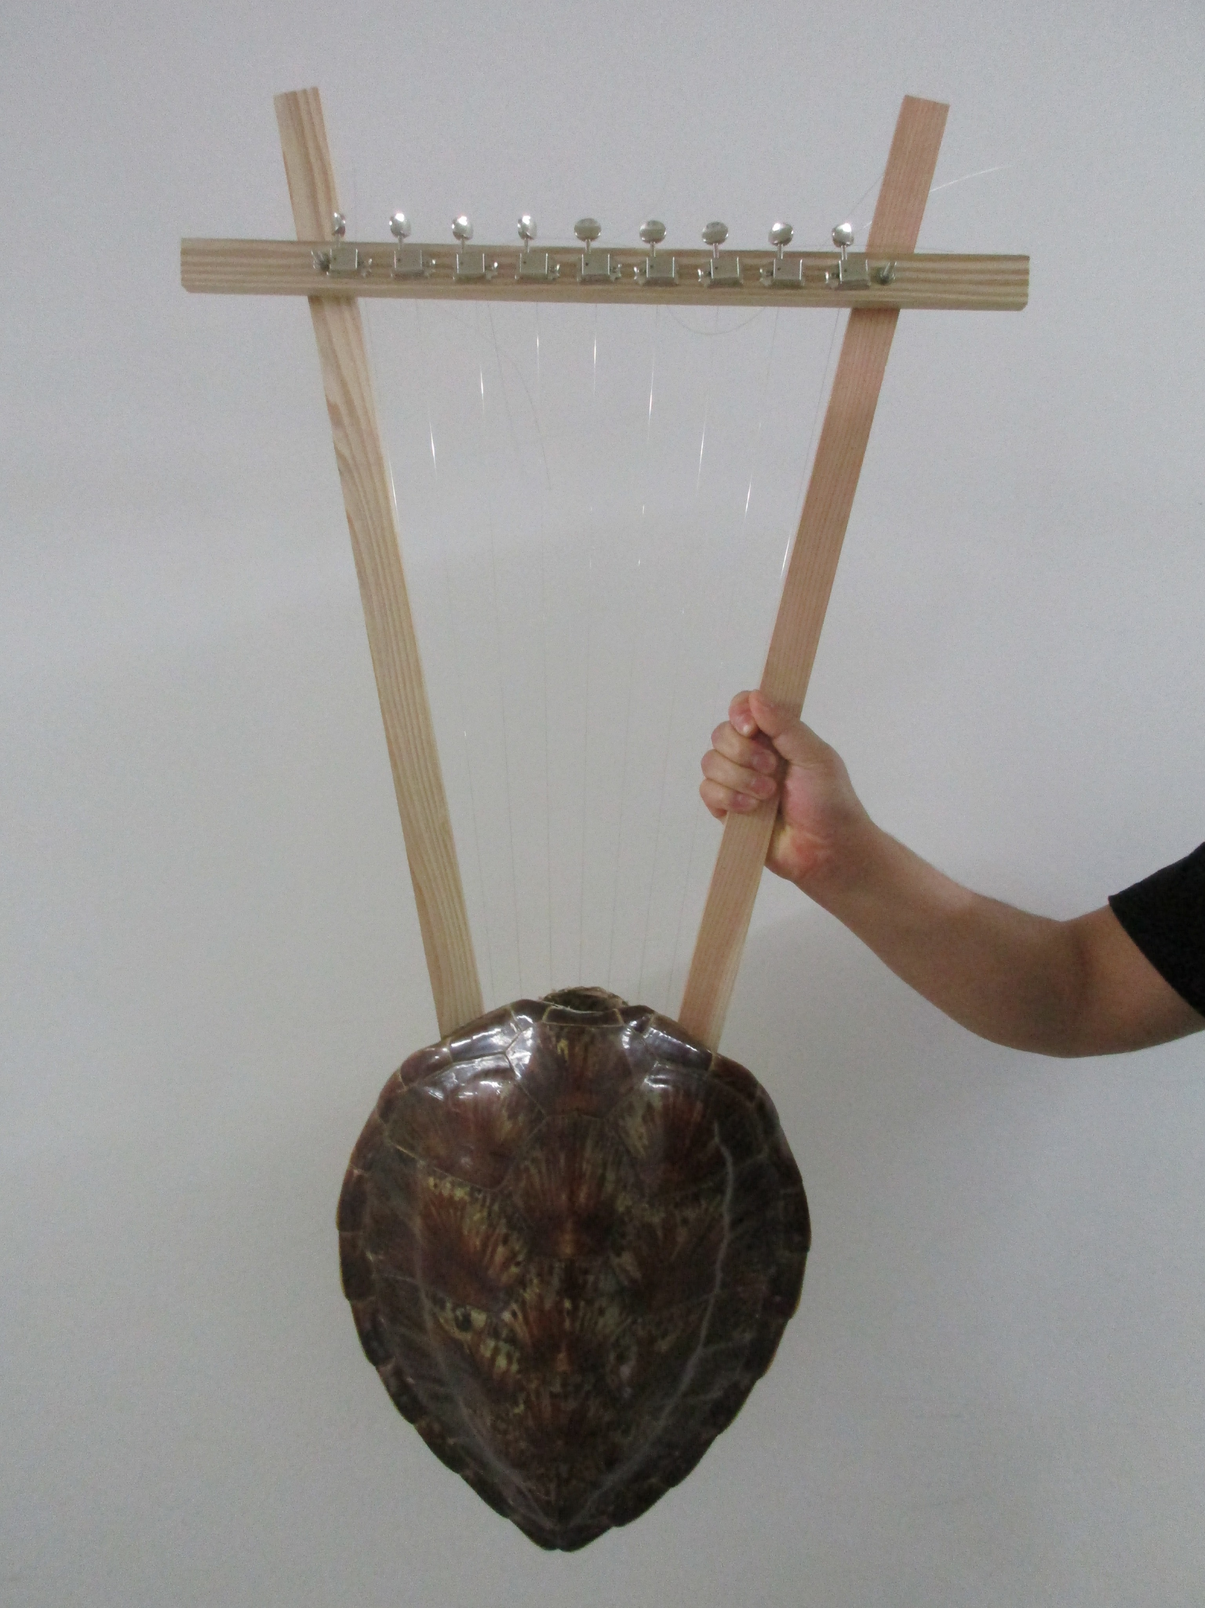
Reconstructed Kithara

Slide 41
Thank you for your kind attention. Your questions / comments are always welcome.
Division of Composition and Conducting, Interfaculty Initiative in Information Studies, The University of Tokyo
taiso.renpoo@gmail.com (SATO, Koji)
itosec@iii.u-tokyo.ac.jp (ITO, Ken)

